Slide 1
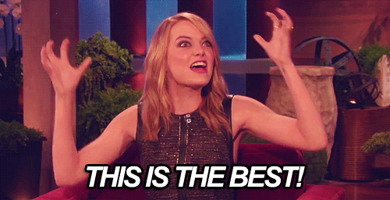
Final review

Slide 2
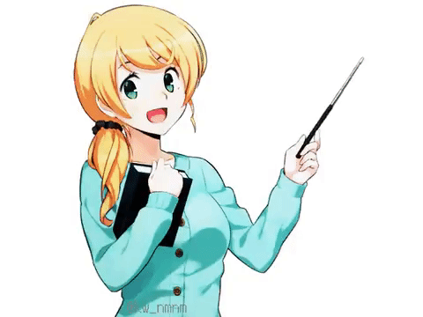
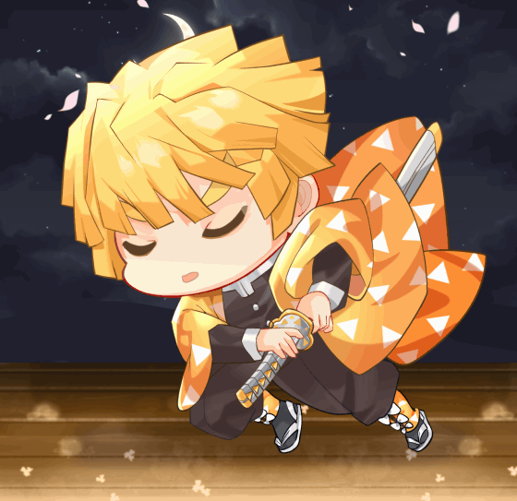
Sure thing!!!!
I prepared for the oral test last weekend.
Did you finish your homework?

Slide 3
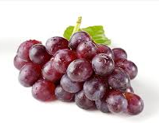
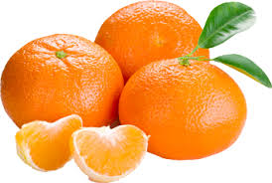
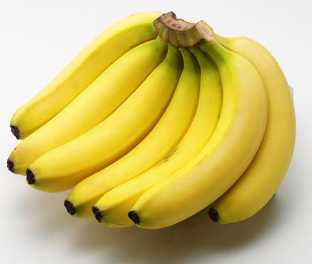
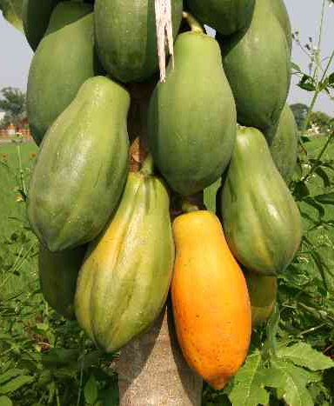
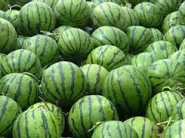
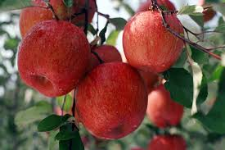
oranges
grapes
bananas
watermelons
apples
papayas

Slide 4
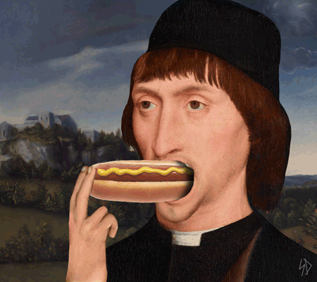
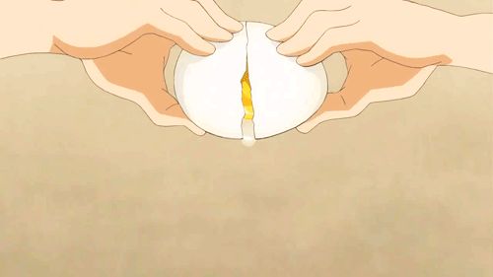
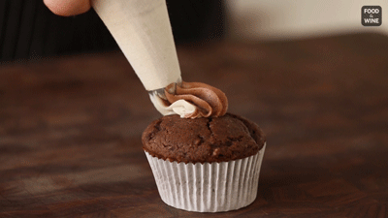
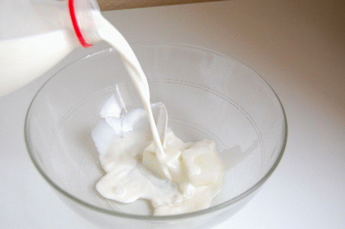
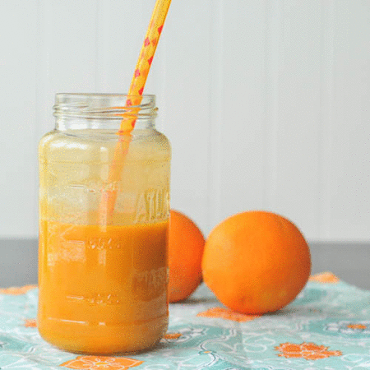
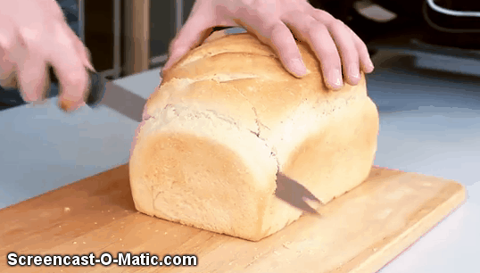
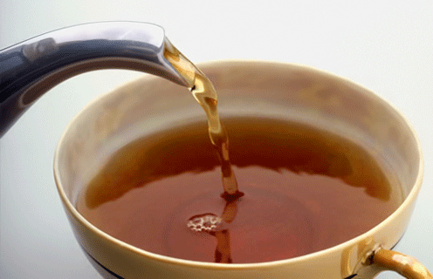
a cupcake
an egg
a hot dog
milk
bread
juice
tea

Slide 5
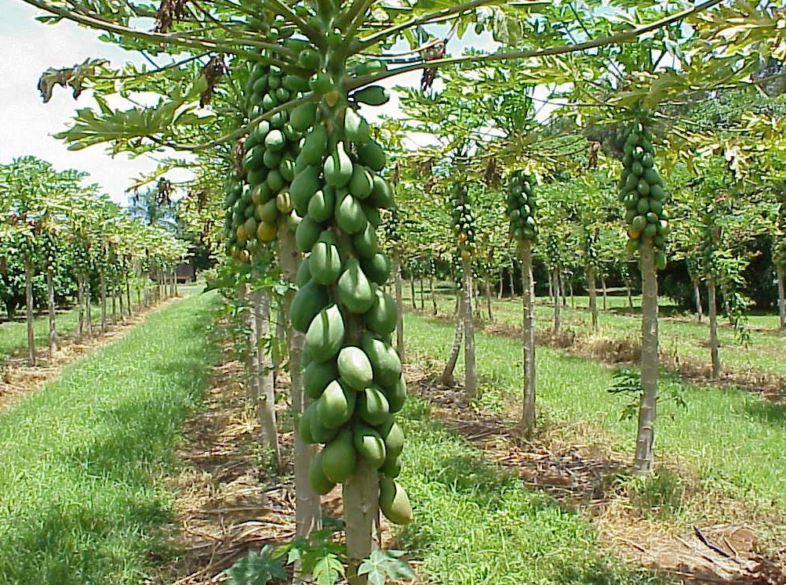
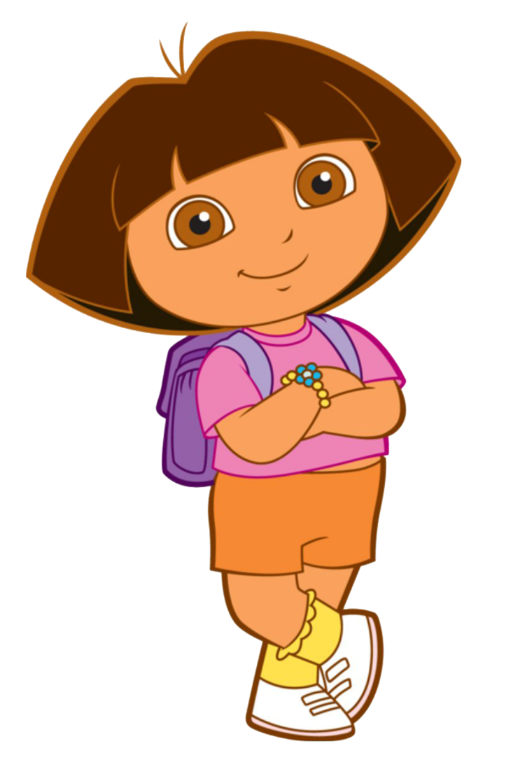
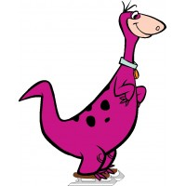
Wow!
What are these?
They’re papayas.

Slide 6
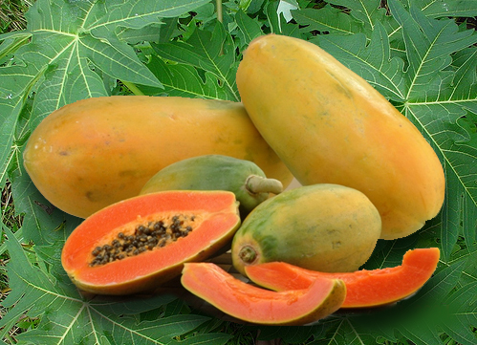
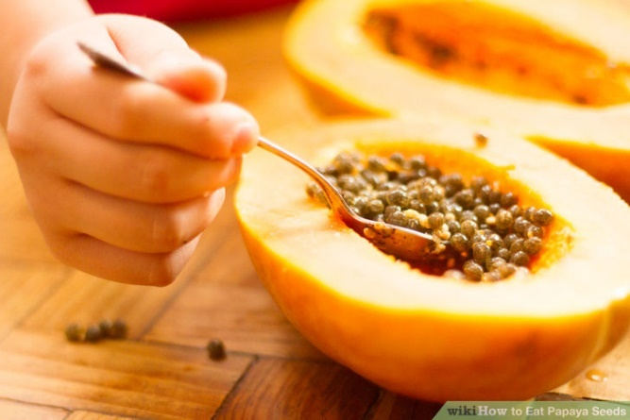
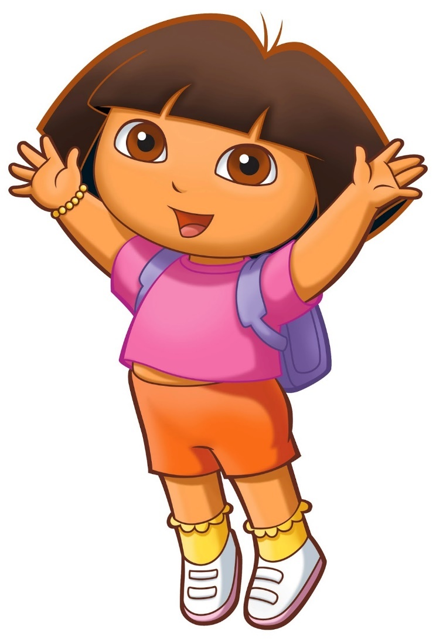
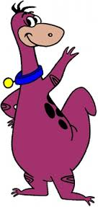
Yes, I do.
Do you like papayas?

Slide 7
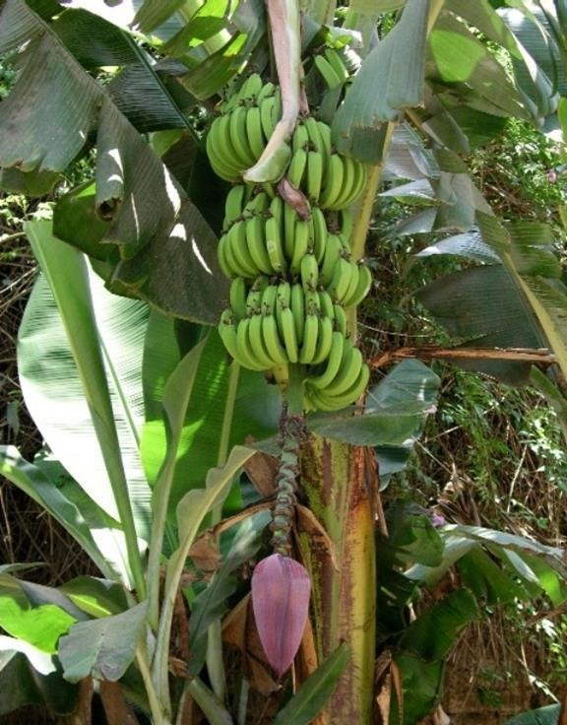
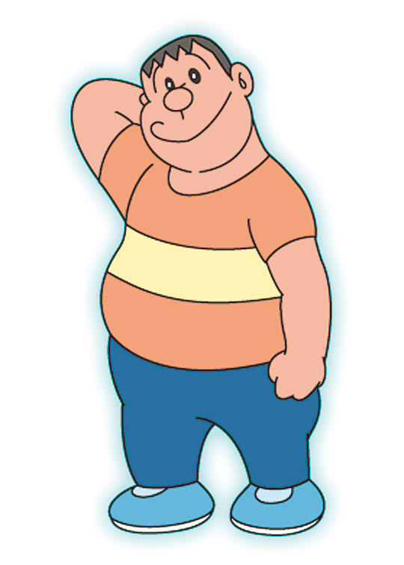
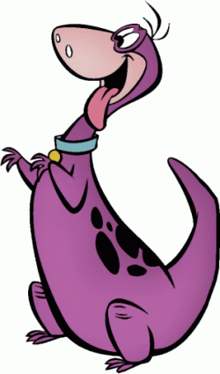
What are these?
They’re bananas.

Slide 8
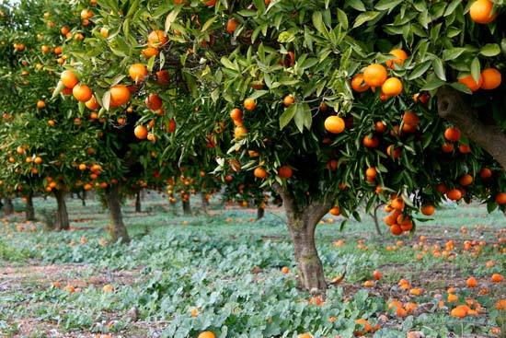
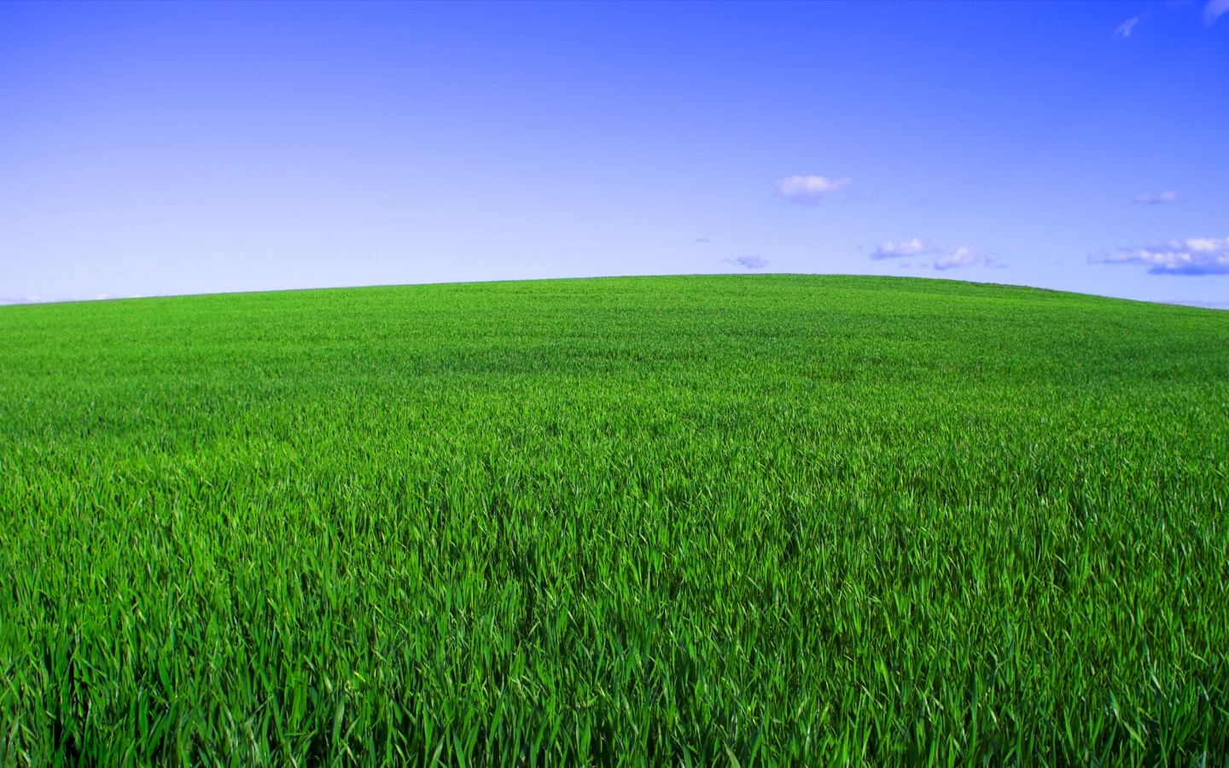
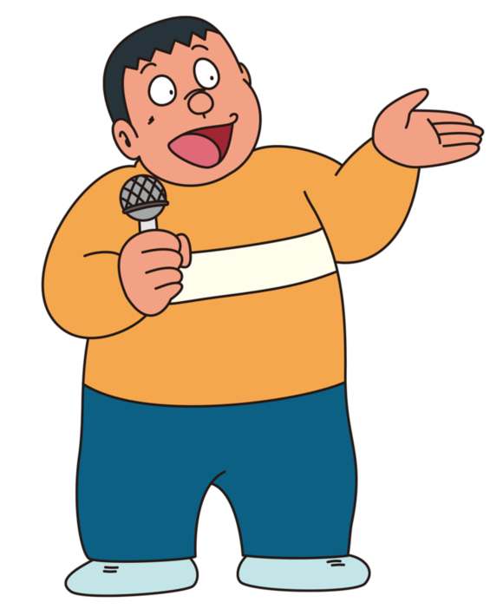
What are those?
They’re oranges.

Slide 9
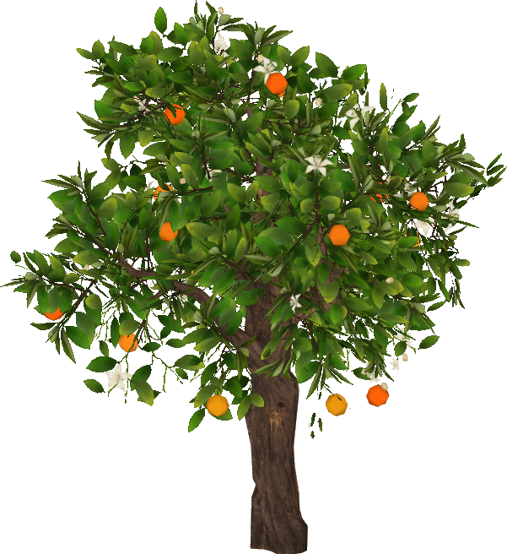
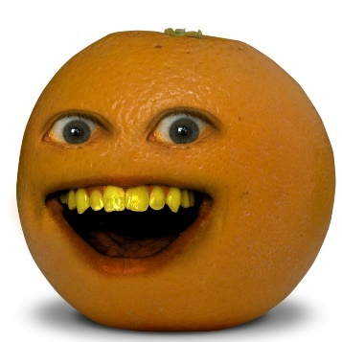
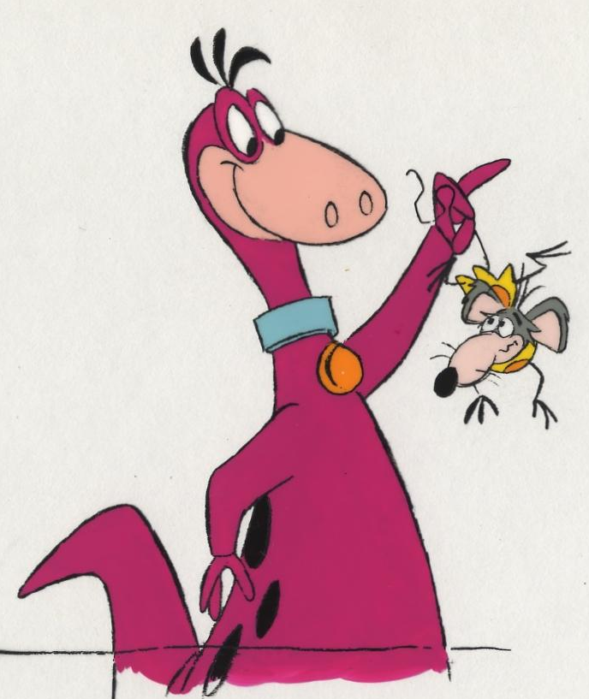
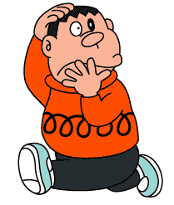
No,I don’t.
Do you like oranges?

Slide 10
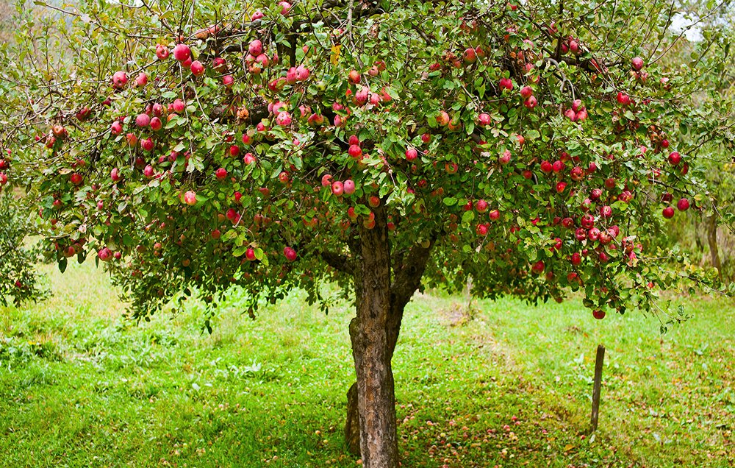
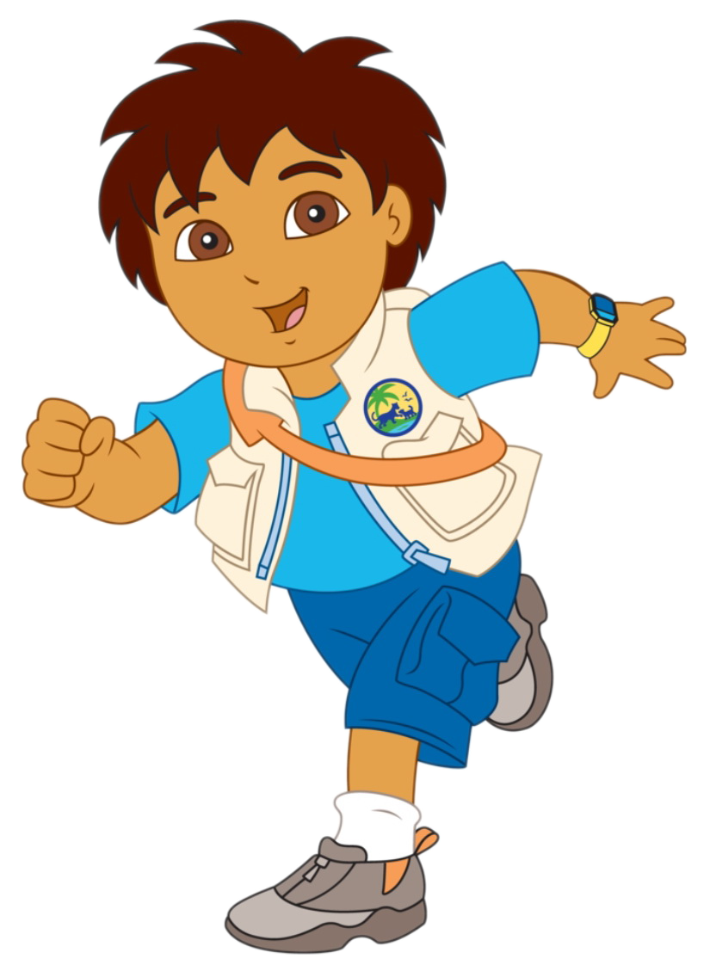
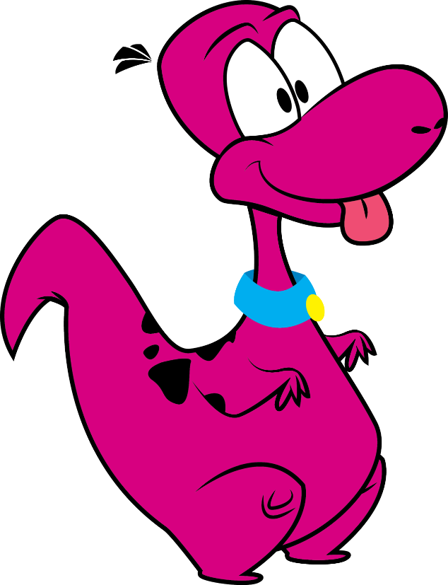
Look,Dino!
Apples.
Great! I like apples.

Slide 11
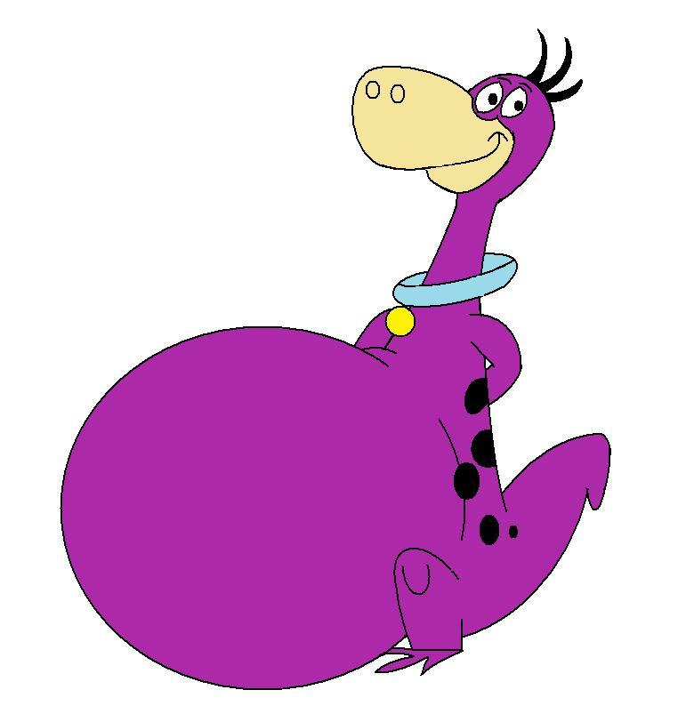
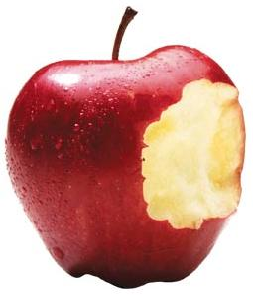
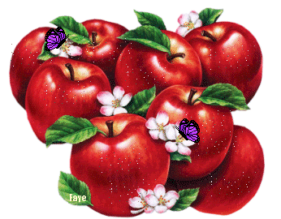
Yummy!

Slide 12
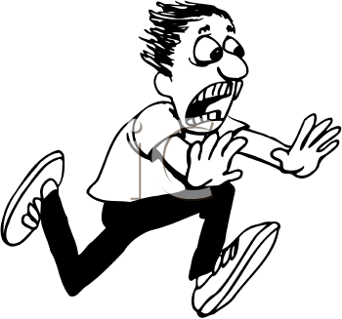
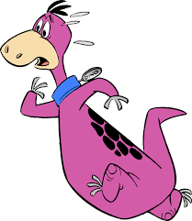
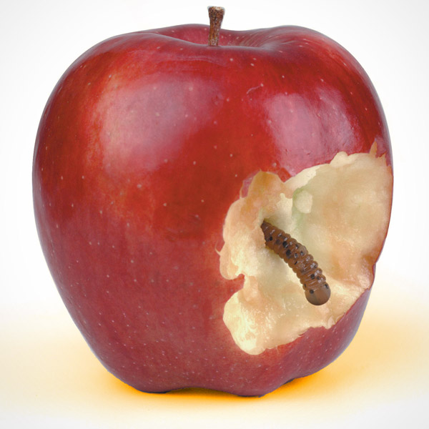
Yuck! I don’t like worms.
Hello!

Slide 13
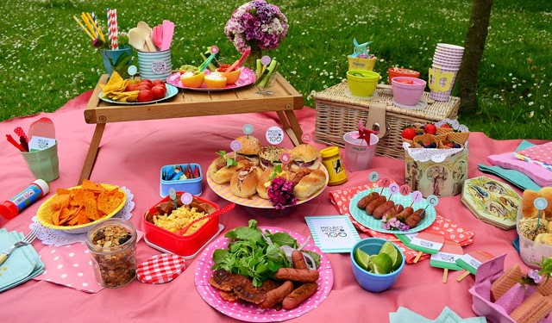
Danny’s mom: Come here, kids.
Danny: What do you want, Irene?
Irene: I want a hot dog. Thank you.

Slide 14
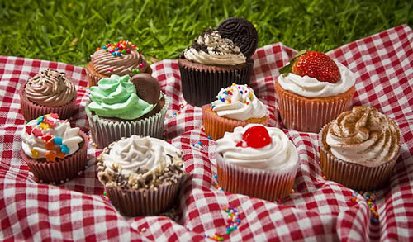
Danny: What do you want, Miss Lee?
Miss Lee: I want two cupcakes, please.
Danny: Here you are.
Miss Lee: Thank you, Danny.

Slide 15
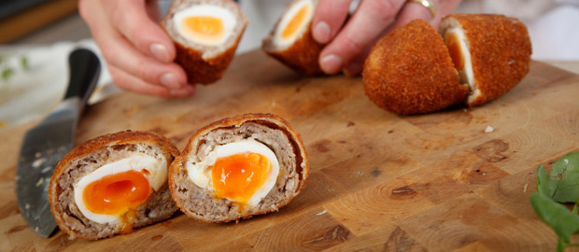
Danny: What do you want, Owen?
Owen: Hmm…Let me see.
What are these?
Danny: They’re eggs.

Slide 16
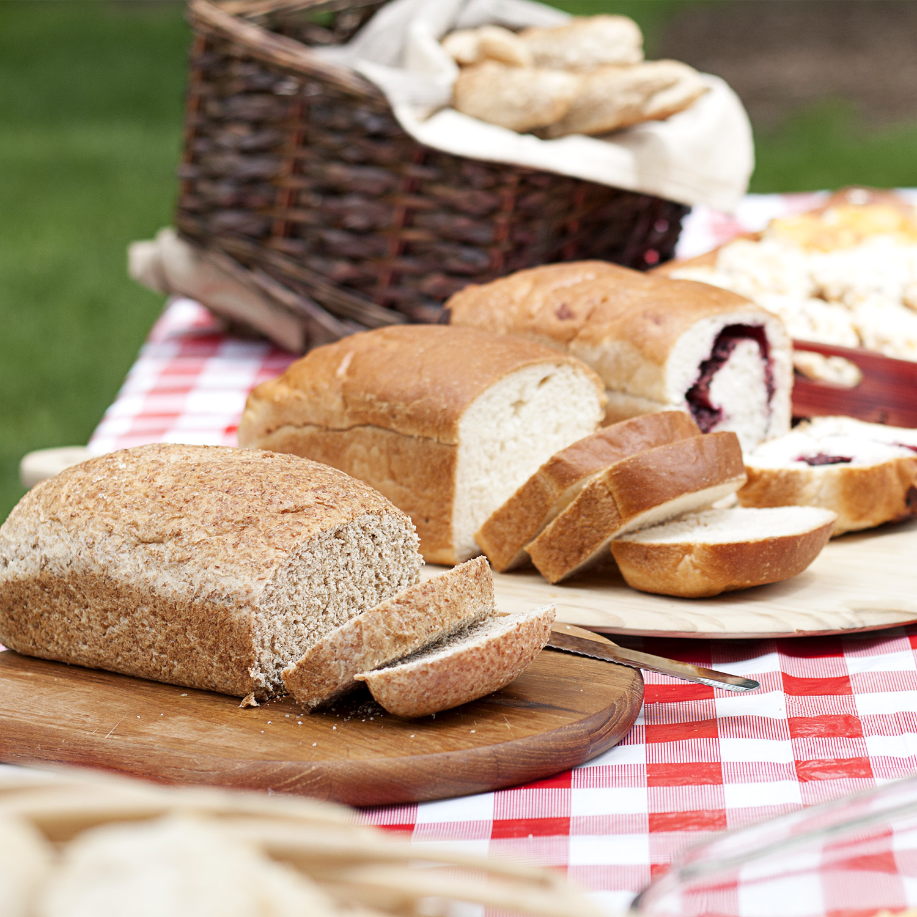
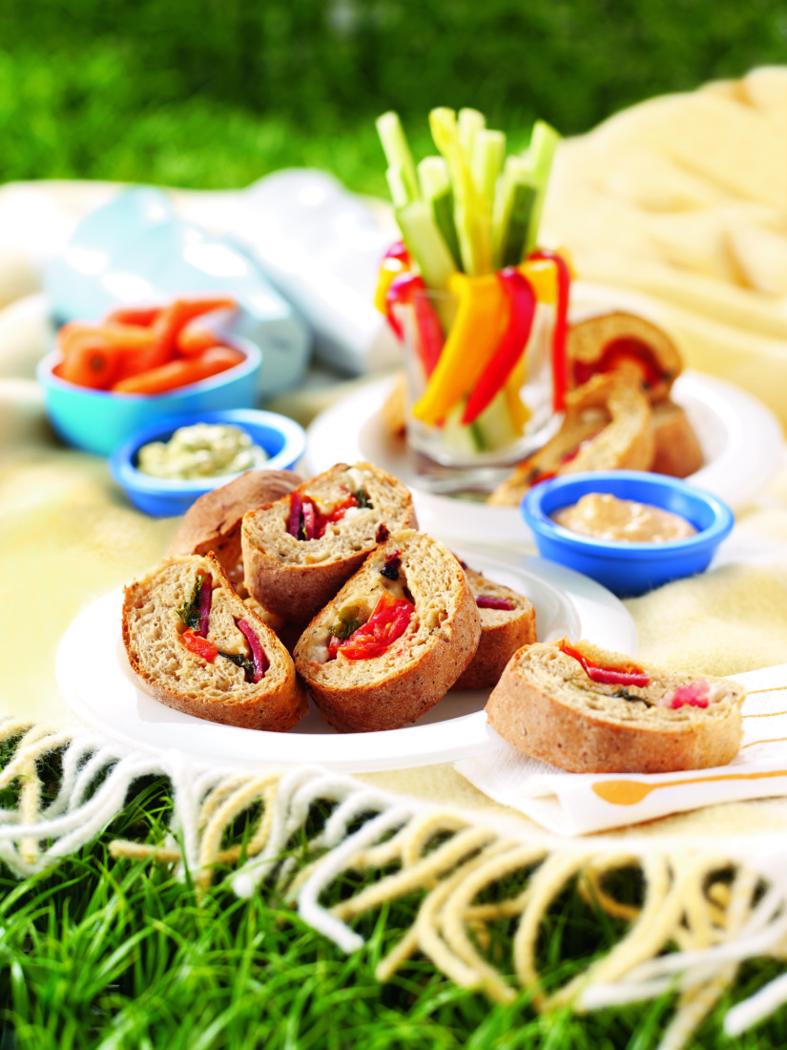
Danny: Hurry up!
Owen: I want some bread, please.
Thanks, Dino.
Dino: Hey! That’s my bread!

Slide 17
ug
og
ip
en
am
un
ock
it
ell
an

Slide 18
-ug
-un

Slide 19
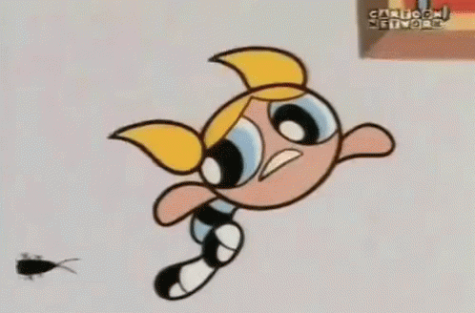
ug
b

Slide 20
m
ug

Slide 21
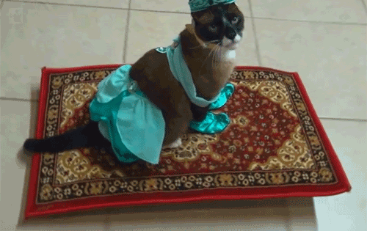
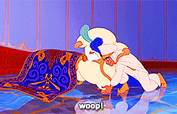
r
ug

Slide 22
un
f

Slide 23
r
un

Slide 24
s
un

Slide 25
og
h

Slide 26
j
og

Slide 27
l
og

Slide 28
ock
l

Slide 29
ock
r
Uluru
Ayers Rock in Australia
艾爾斯巨石是世界上最大的獨塊岩體，長35km，寬2km，高330m。

Slide 30
ock
s

Slide 31
ip
l

Slide 32
s
ip

Slide 33
z
ip

Slide 34
k
it

Slide 35
qu
it

Slide 36
s
it

Slide 37
h
en

Slide 38
p
en

Slide 39
t
en

Slide 40
b
ell

Slide 41
s
ell

Slide 42
y
ell

Slide 43
h
am

Slide 44
j
am

Slide 45
S
am
Sam Claflin

Slide 46
m
an

Slide 47
f
an

Slide 48
v
an

Slide 49
Daily Talk
Yummy!

Slide 50
Daily Talk
Yuck!

Slide 51
Daily Talk
Here you are.

Slide 52
Daily Talk
Hurry up!

Slide 54
Unit 3~ Unit 4
Review 2

Slide 55
Get your color chips ready…
One chip for each color!

Slide 56
Question 1.
am an en ell
請依序排出聽到的音組:

Slide 57
Question 2.
ip it og ug
請依序排出聽到的音組:

Slide 58
Question 3.
run sun rock lock
The ____ will change its colors by the _____.

Slide 59
Question 4.
bell this that yell
What’s ______? It’s a ______.
Don’t _____. We’re in the national park.

Slide 60
Question 5.
these those this that
What’s ______? It’s an apple.
What are _____? They’re bananas.

Slide 61
Question 6.
請仔細聽單字出現順序!

Slide 62
Question 7.
請仔細聽單字出現順序!

Slide 63
Question 8.
bread egg cupcake grape
哪些食物前面要接 a

Slide 64
Question 9.
orange egg roll apple pie ice cream
哪些食物前面要接 an

Slide 65
Question 10.
tacos milk tea bread juice
哪些食物前面要接 some

Slide 66
Question 11.
do want? What you
排出正確句子!

Slide 67
Question 12.
I want some ______ , ______, and ______.

Slide 68
Question 13.
these those iron eggs tea eggs
What are ______?
They’re _____ and ______.

Slide 69
Question 14.
do like don’t can’t
Do you like oranges?
Yes, I ____. No, I _____.

Slide 70
Question 15.
按照圖片的順序由左向右排生活用語
Yuck! Hurry up! Yummy! Here you are.

Slide 71
Question 16.
這是在做什麼事?
draw write a letter sing cook

Slide 72
Question 17.
這是在做什麼事?
dance write a letter swim sing Christmas
to Santa carols

Slide 73
Question 18.
Uluru is from ______.
the USA Taiwan the UK Australia

Slide 74
Question 19.
有哪些說法可以表達「噁心」

Slide 75
Question 20.
這兩幅名畫的作者是誰?
畢卡索 達文西 梵谷 孟克
Picasso Da Vinci Van Gogh Munch

Slide 76
Question 23.
下列哪些與Christmas有關

Slide 77
Wish you luck Tomorrow!!!

